Slide 1

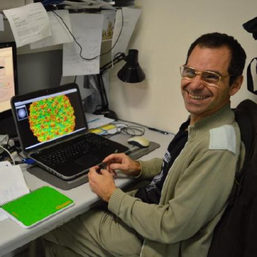

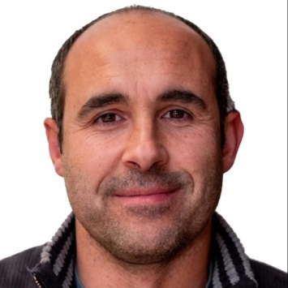





Roberto Marabini
Marcos Grajera
Pablo Conesa
Carlos P. Mata
Marta Martínez
I2PC-INSTRUCT COURSE:
INTRODUCTION TO
MODEL BUILDING USING SCIPION
CNB-CSIC, Madrid, June 17th – June 18th, 2024

Slide 2
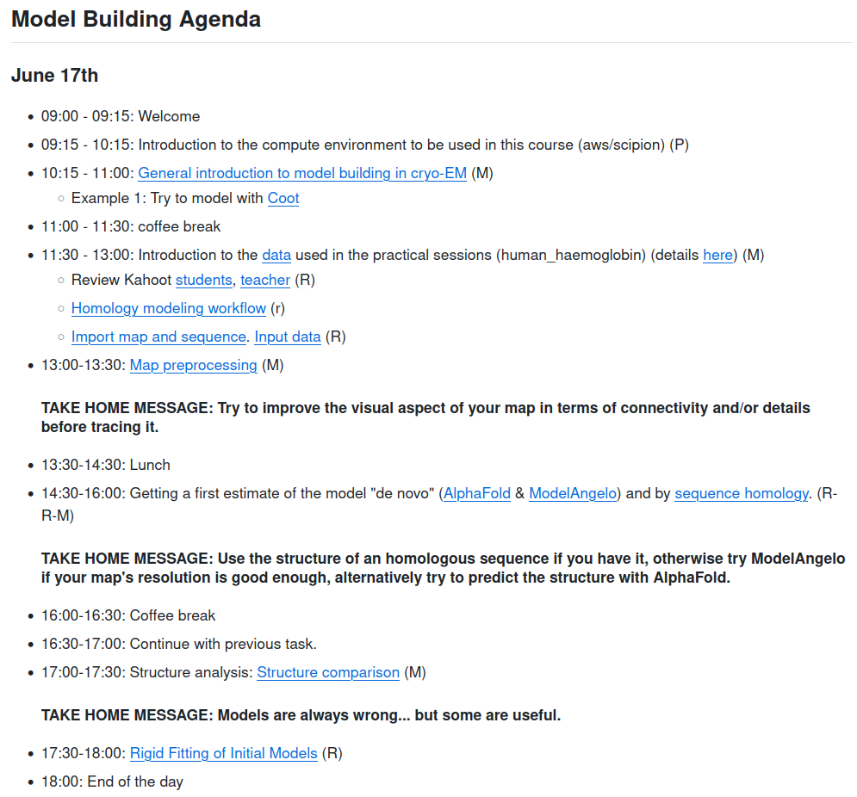
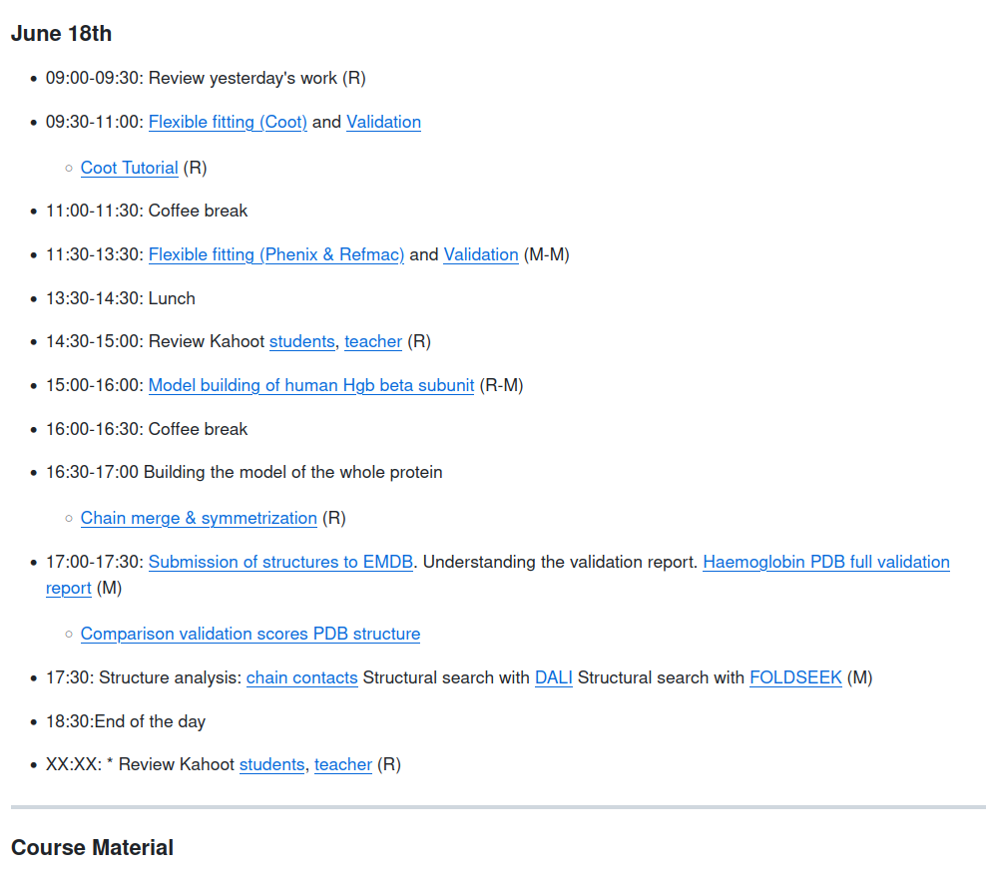

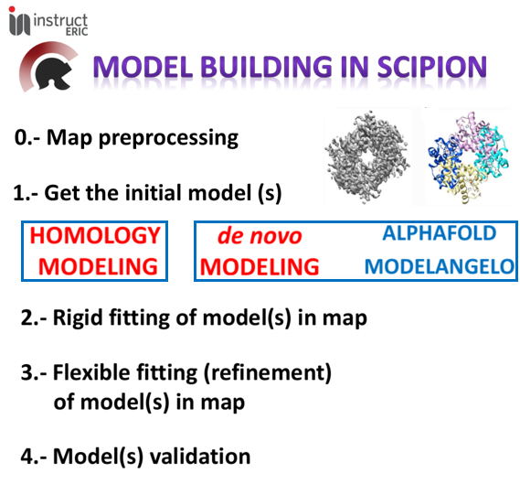
https://github.com/I2PC/scipion-courses/wiki/Course_June17-21_2024
I2PC-INSTRUCT course: INTRODUCTION TO FLEXIBILITY and MODEL BUILDING using SCIPION
Ask questions in the chat!!!

Slide 3
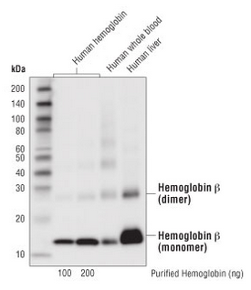
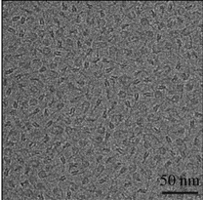
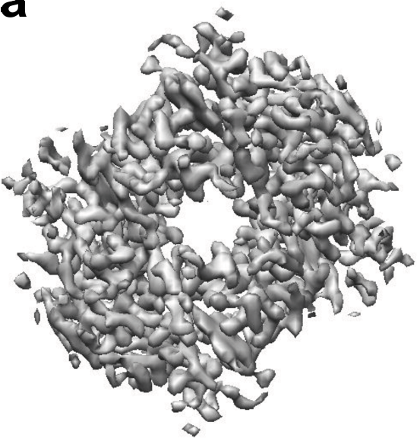
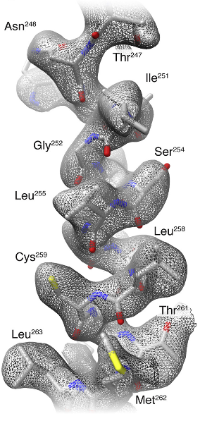
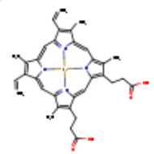
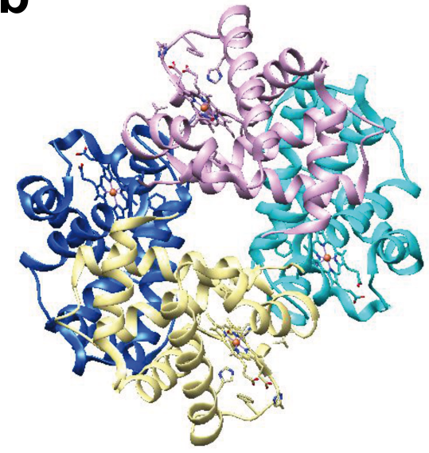
Modeling proteins from cryo-EM data
Approach to the problem: Atomic interpretation of the map
Density map
Model building
SPA/STA workflow
www.cellsignal.com
2 Hemoglobin subunit α (141 aa)
4 HEME
2 Hemoglobin subunit β (146 aa)
In real world sometimes
you don’t have all data
Atomic model
(Khoshouei et al., 2017)

Slide 4
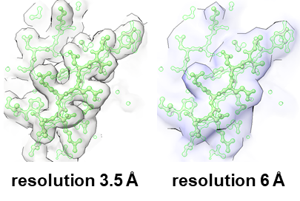
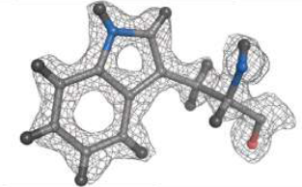
Modeling proteins from cryo-EM data
Approach to the problem: Atomic interpretation of the map
Density map
Model building
SPA/STA workflow
www.cellsignal.com
2 Hemoglobin subunit α (141 aa)
4 HEME
2 Hemoglobin subunit β (146 aa)
Best map !!!
Resolution (global and local):
< 4.0 to 4.5 Å
Atomic model
(Khoshouei et al., 2017)

Slide 5
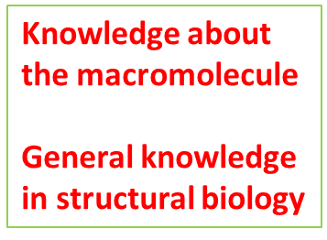
Modeling proteins from cryo-EM data
Approach to the problem: Atomic interpretation of the map
Density map
Model building
SPA/STA workflow
www.cellsignal.com
2 Hemoglobin subunit α (141 aa)
4 HEME
2 Hemoglobin subunit β (146 aa)
Best map !!!
Resolution (global and local):
< 4.0 to 4.5 Å
Atomic model
(Khoshouei et al., 2017)

Slide 6
Modeling proteins from cryo-EM data
Approach to the problem: Atomic interpretation of the map
Electron density map
“All models are wrong, but some are useful”
(George P. Box)
Atomic model
(Khoshouei et al., 2017)

Slide 7

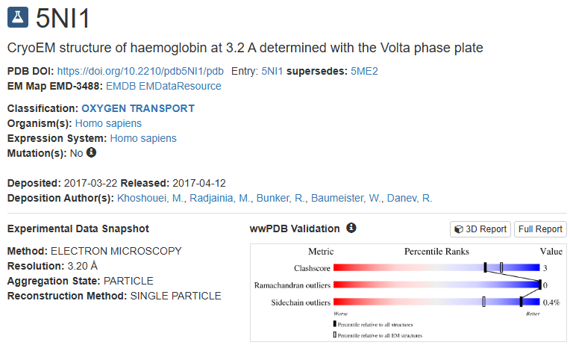
Modeling proteins from cryo-EM data
Approach to the problem: Atomic interpretation of the map
Electron density map
“All models are wrong, but some are useful”
(George P. Box)
Atomic model
(Khoshouei et al., 2017)

Slide 8
Modeling proteins from cryo-EM data
Model building
Basic steps
Tools

Slide 9
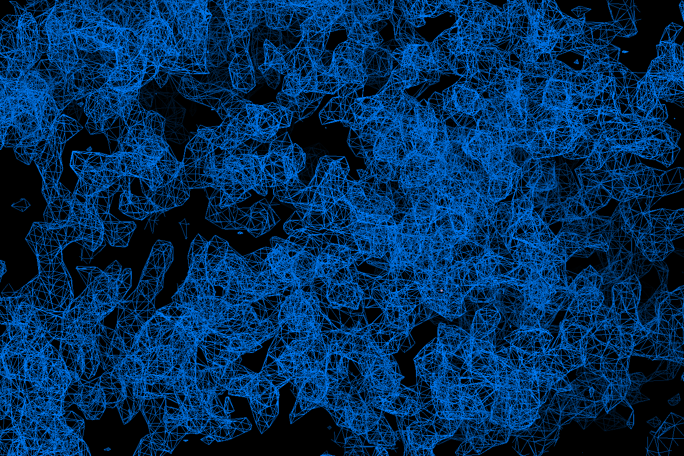
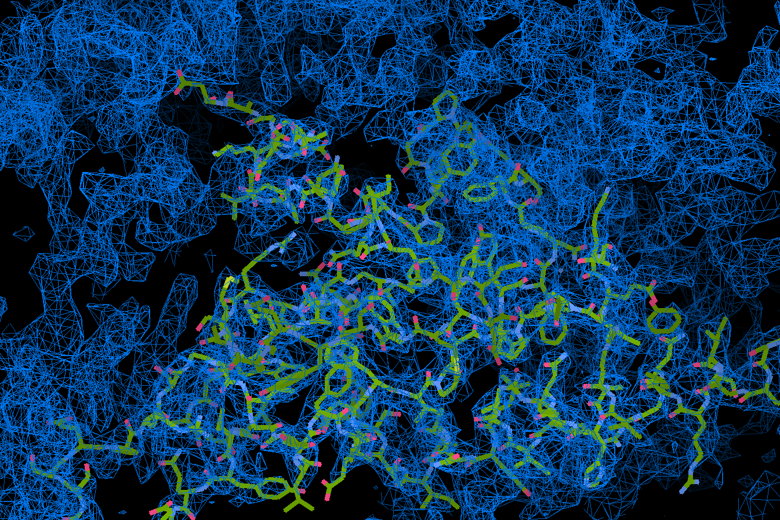

Modeling proteins from cryo-EM data
https://github.com/I2PC/scipion-courses/wiki/modeling_with_coot
SEED

Slide 10
Modeling proteins from cryo-EM data
Model building
Basic steps
Tools

Slide 11
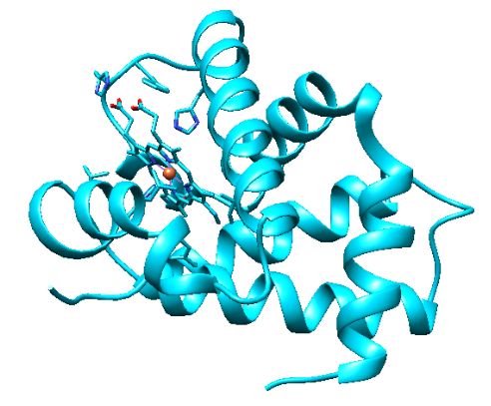
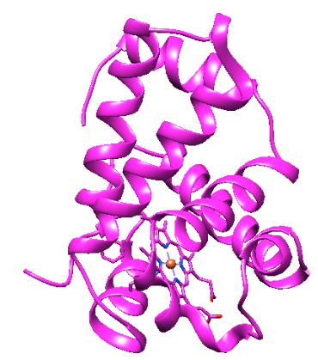
Step 1.- Getting the initial model(s): Structure prediction
de novo
modeling
AlphaFold
ModelAngelo
(template NOT needed)
www.cellsignal.com
4 HEME
2 Hemoglobin subunit α (141 aa)
2 Hemoglobin subunit β (146 aa)
SEQUENCE

Slide 12

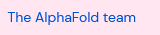
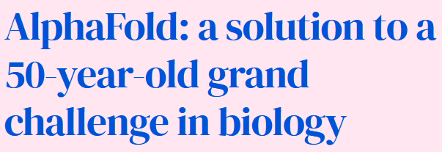

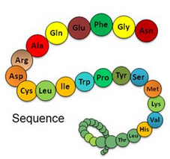
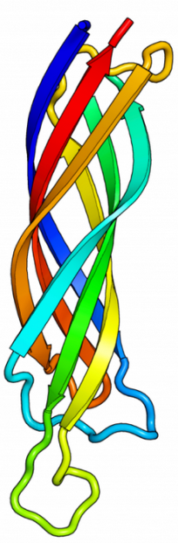
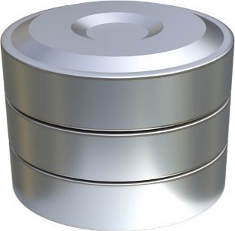
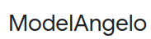
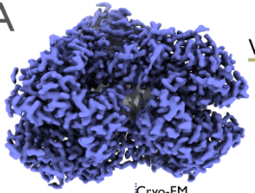
Step 1.- Getting the initial model(s): Structure prediction
de novo
modeling
AlphaFold
ModelAngelo
(template NOT needed)
3D structure
Sequence
3D structure
Cryo-EM map

Slide 13
Step 1.- Getting the initial model(s): Structure prediction
de novo
modeling
Homology
modeling
AlphaFold
ModelAngelo
(template NOT needed)
Our proteins borrow
the structure
of similar proteins
(template needed)
www.cellsignal.com
4 HEME
2 Hemoglobin subunit α (141 aa)
2 Hemoglobin subunit β (146 aa)
SEQUENCE
initial model = real model
1st clue:
Skeleton of α carbons
and
many side chains

Slide 14
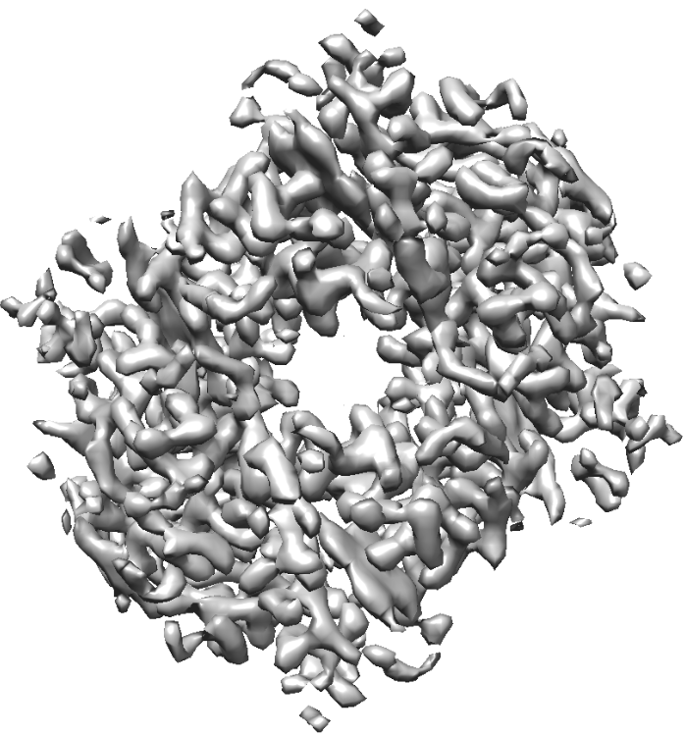
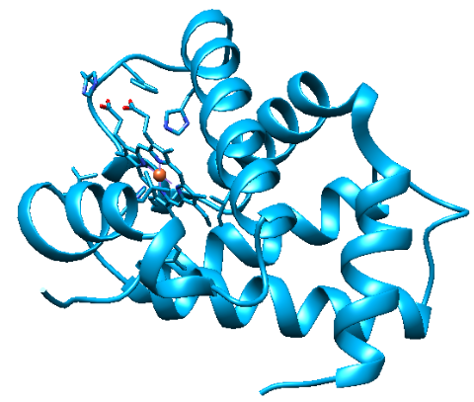
Step 2.- Rigid fitting of model(s) in map

Slide 15
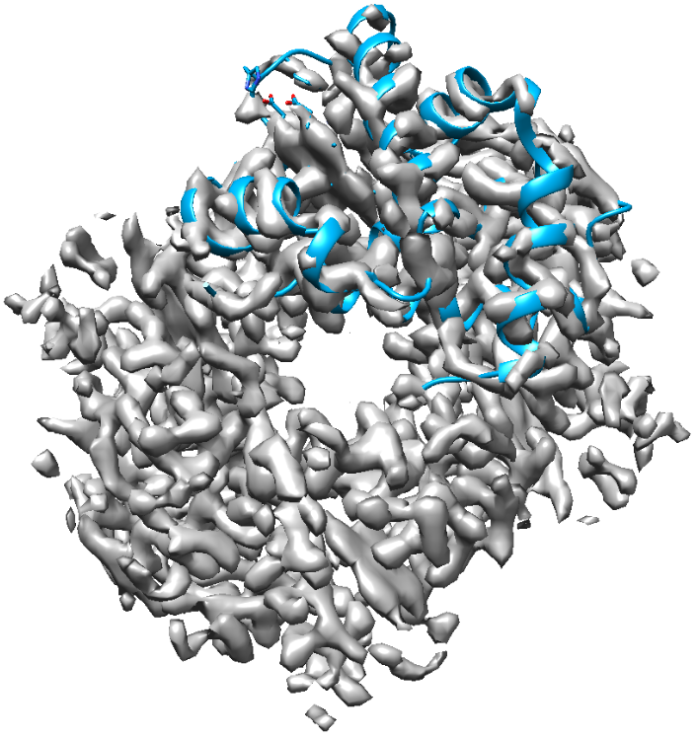
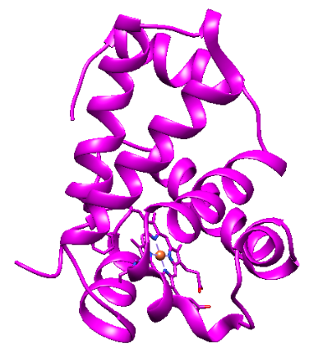
Step 2.- Rigid fitting of model(s) in map

Slide 16
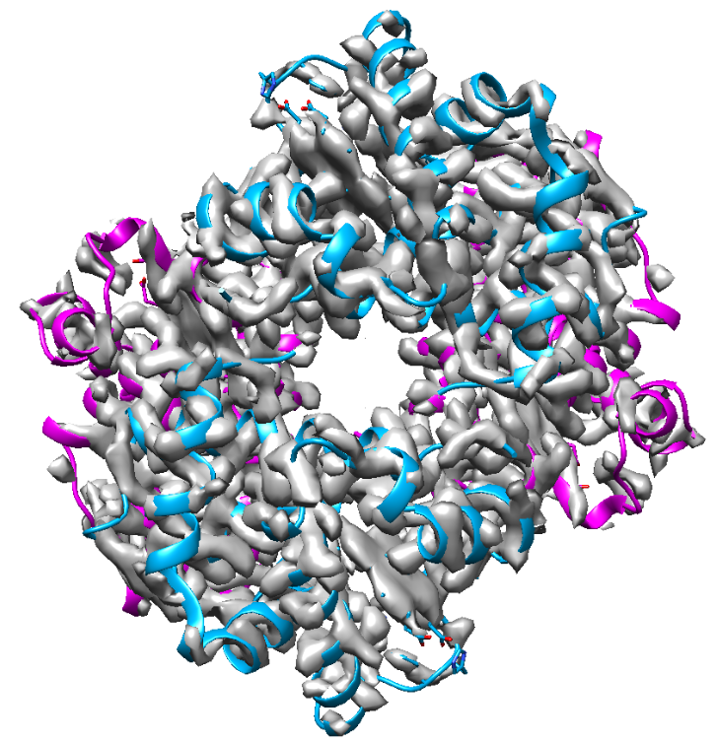
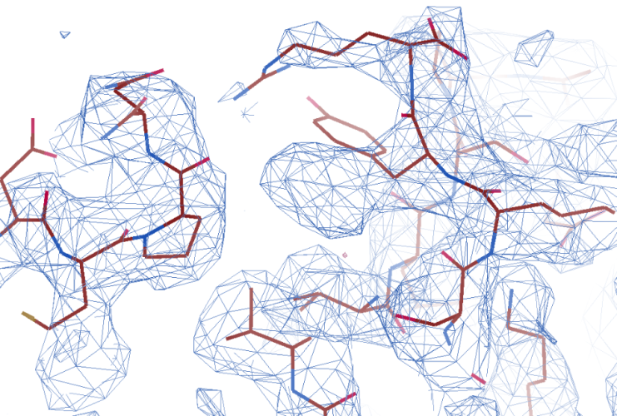
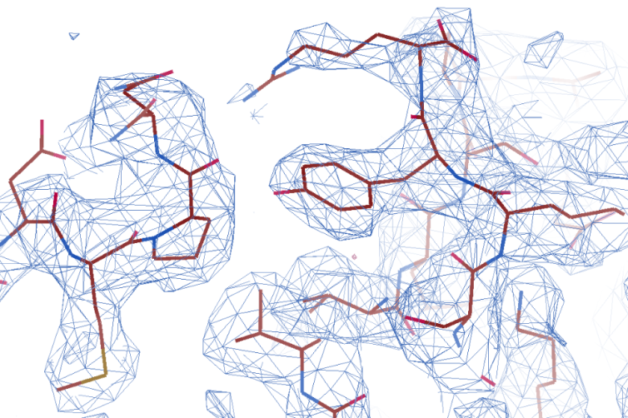
Step 3.- Flexible fitting (refinement) of model(s) in map
Getting the final model(s)
Manual and automatic

Slide 17
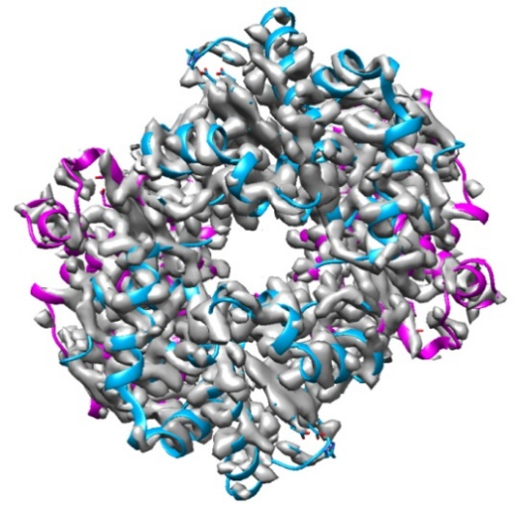
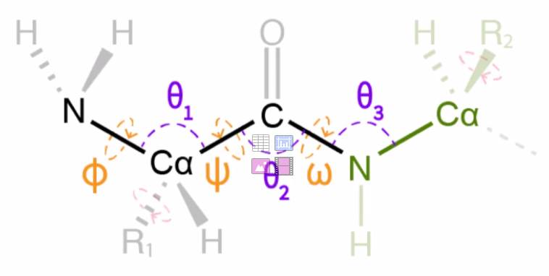


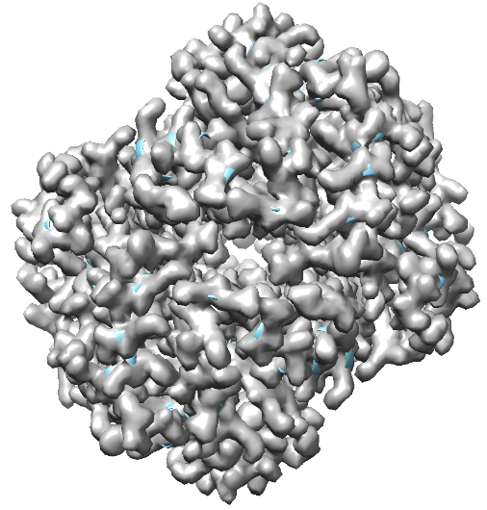

Step 4.- Model(s) validation
Is this structure reliable?
Map and model similarity
Geometry
Map/model
fitting
PDB
Is this structure similar
to the structures of the database?
(Bond lengths, angles, contacts …)
Is the map derived from the model similar to the original map?
Q (Submission)

Slide 18
Modeling proteins from cryo-EM data
Model building
Basic steps
1.- Get the initial model (s)
2.- Rigid fitting of model(s) in map
3.- Flexible fitting (refinement)
of model(s) in map
4.- Model(s) validation
Tools

Slide 19
Modeling proteins from cryo-EM data
Model building
Basic steps
1.- Get the initial model (s)
2.- Rigid fitting of model(s) in map
3.- Flexible fitting (refinement)
of model(s) in map
4.- Model(s) validation
Tools

Slide 20
Modeling proteins from cryo-EM data
Model building
Basic steps
0.- Map preprocessing
1.- Get the initial model (s)
2.- Rigid fitting of model(s) in map
3.- Flexible fitting (refinement)
of model(s) in map
4.- Model(s) validation
Tools

Slide 21
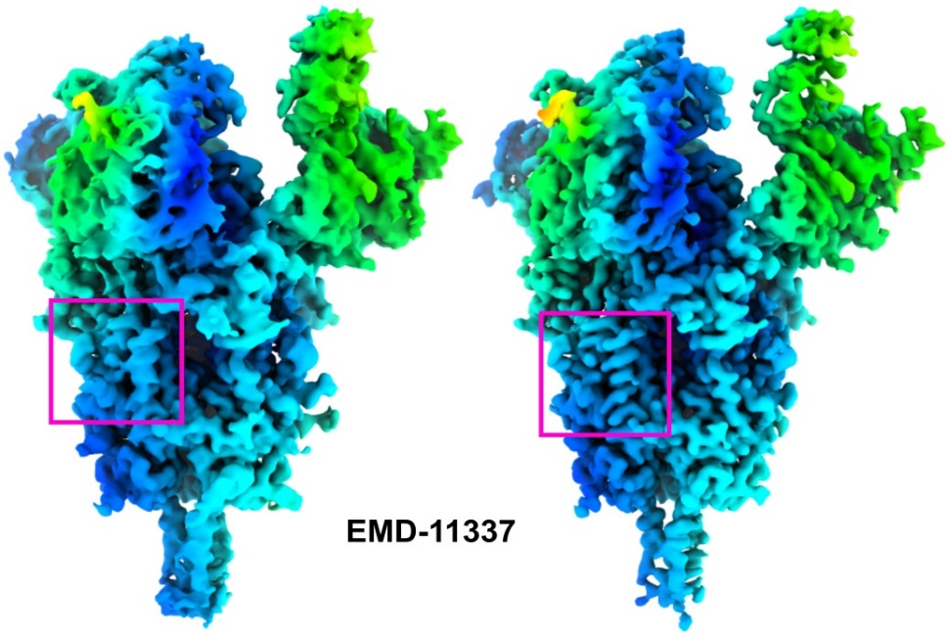
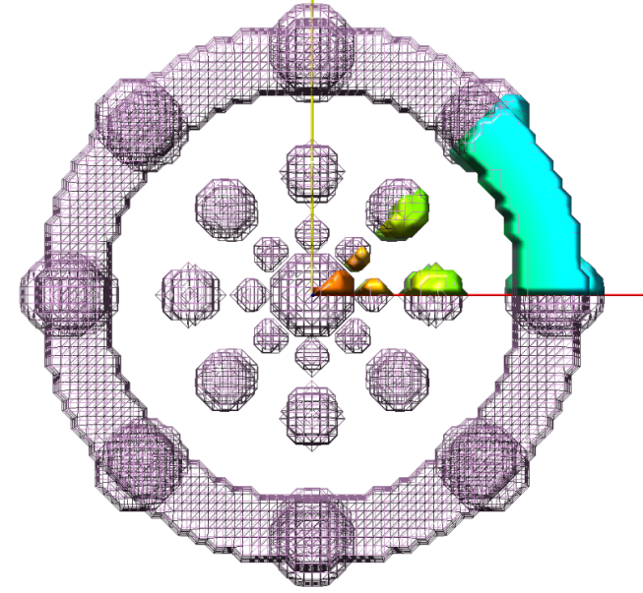
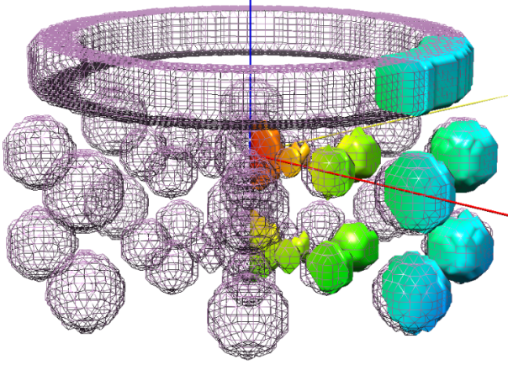
Step 0.- Map preprocessing
Map optimization
(sharpening, improving density)
Global and/or locally
DeepEMhancer (Sánchez et al., 2020)
Extract asymmetric unit (geometrical)
sym C8

Slide 22
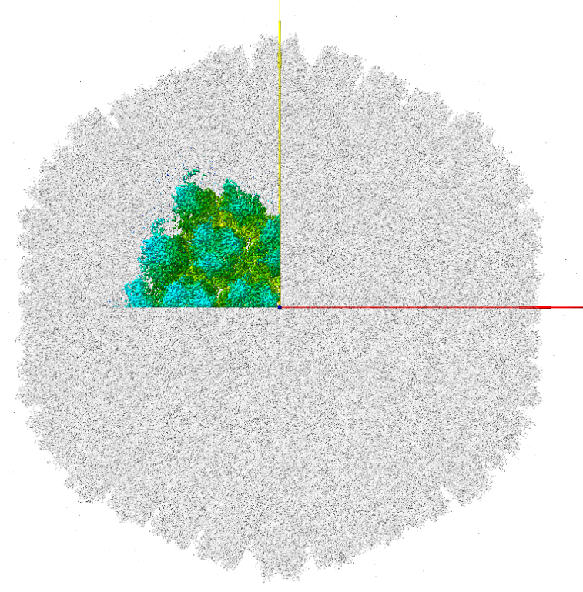
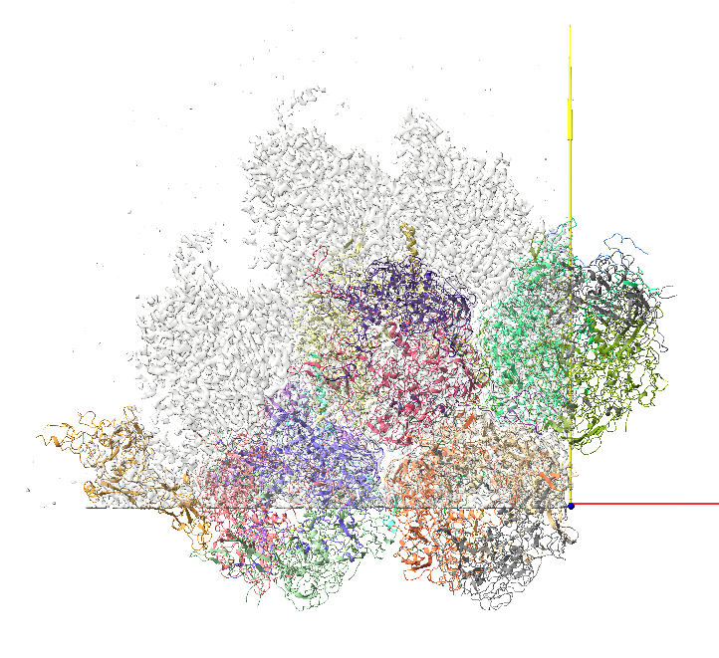
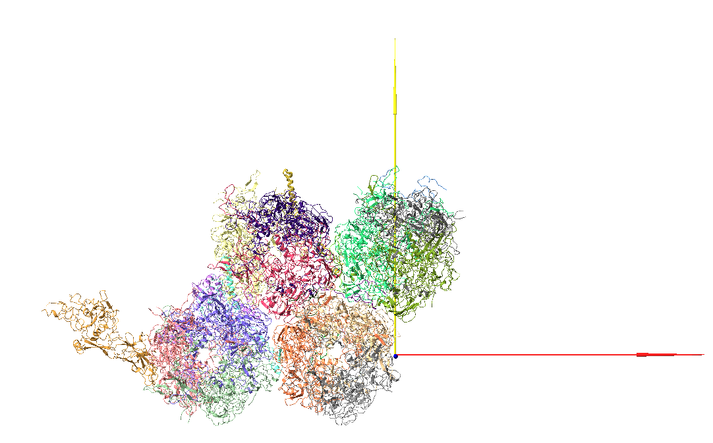
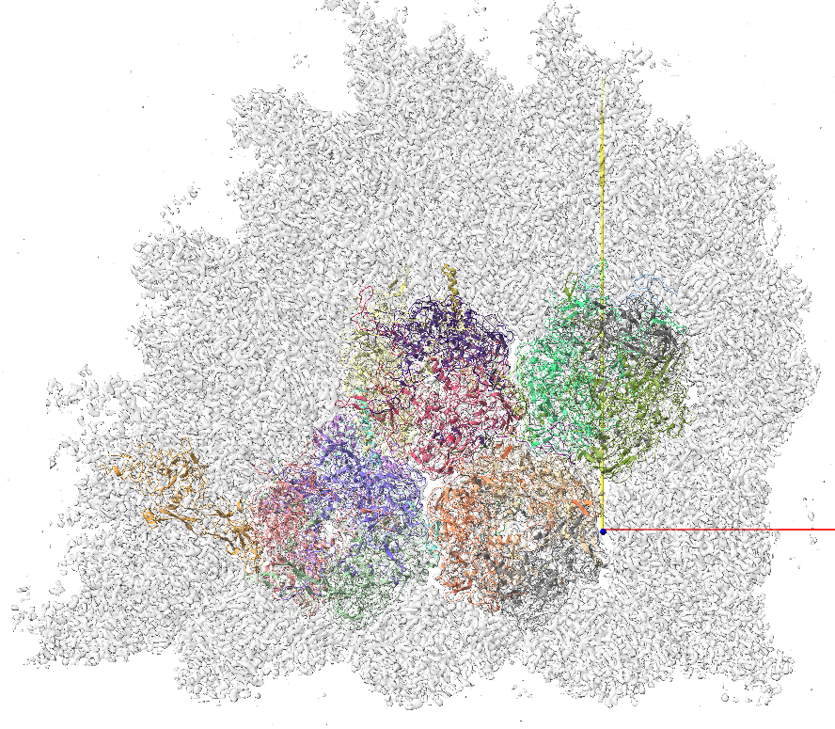
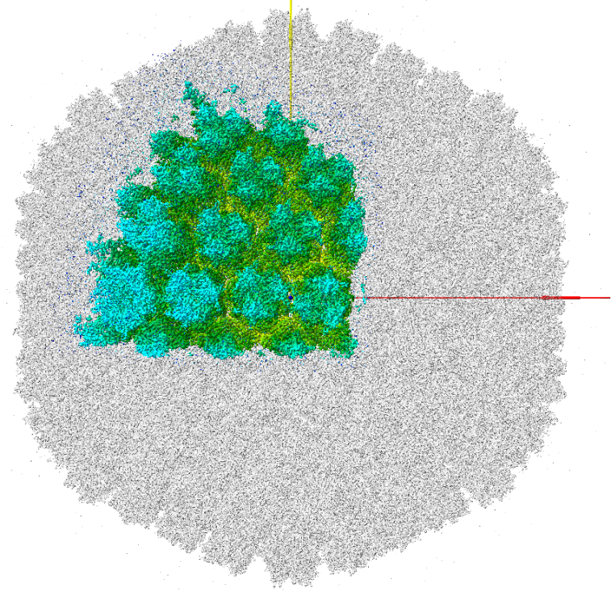
Asymmetric unit
(geometrical)
EMD-10768
6YBA
(biological)

Slide 23
Modeling proteins from cryo-EM data
Model building
Basic steps
0.- Map preprocessing
1.- Get the initial model (s)
2.- Rigid fitting of model(s) in map
3.- Flexible fitting (refinement)
of model(s) in map
4.- Model(s) validation
Tools

Slide 24



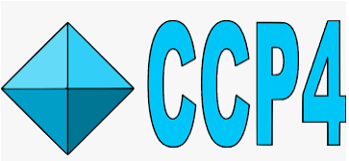
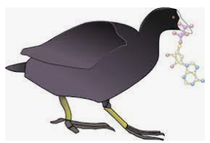
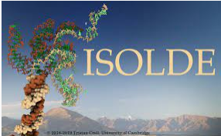
Tools
* Borrowed from crystallography
* Specifically designed for cryo-EM data
Programs & Suites
Interactive & Automatic

Slide 25
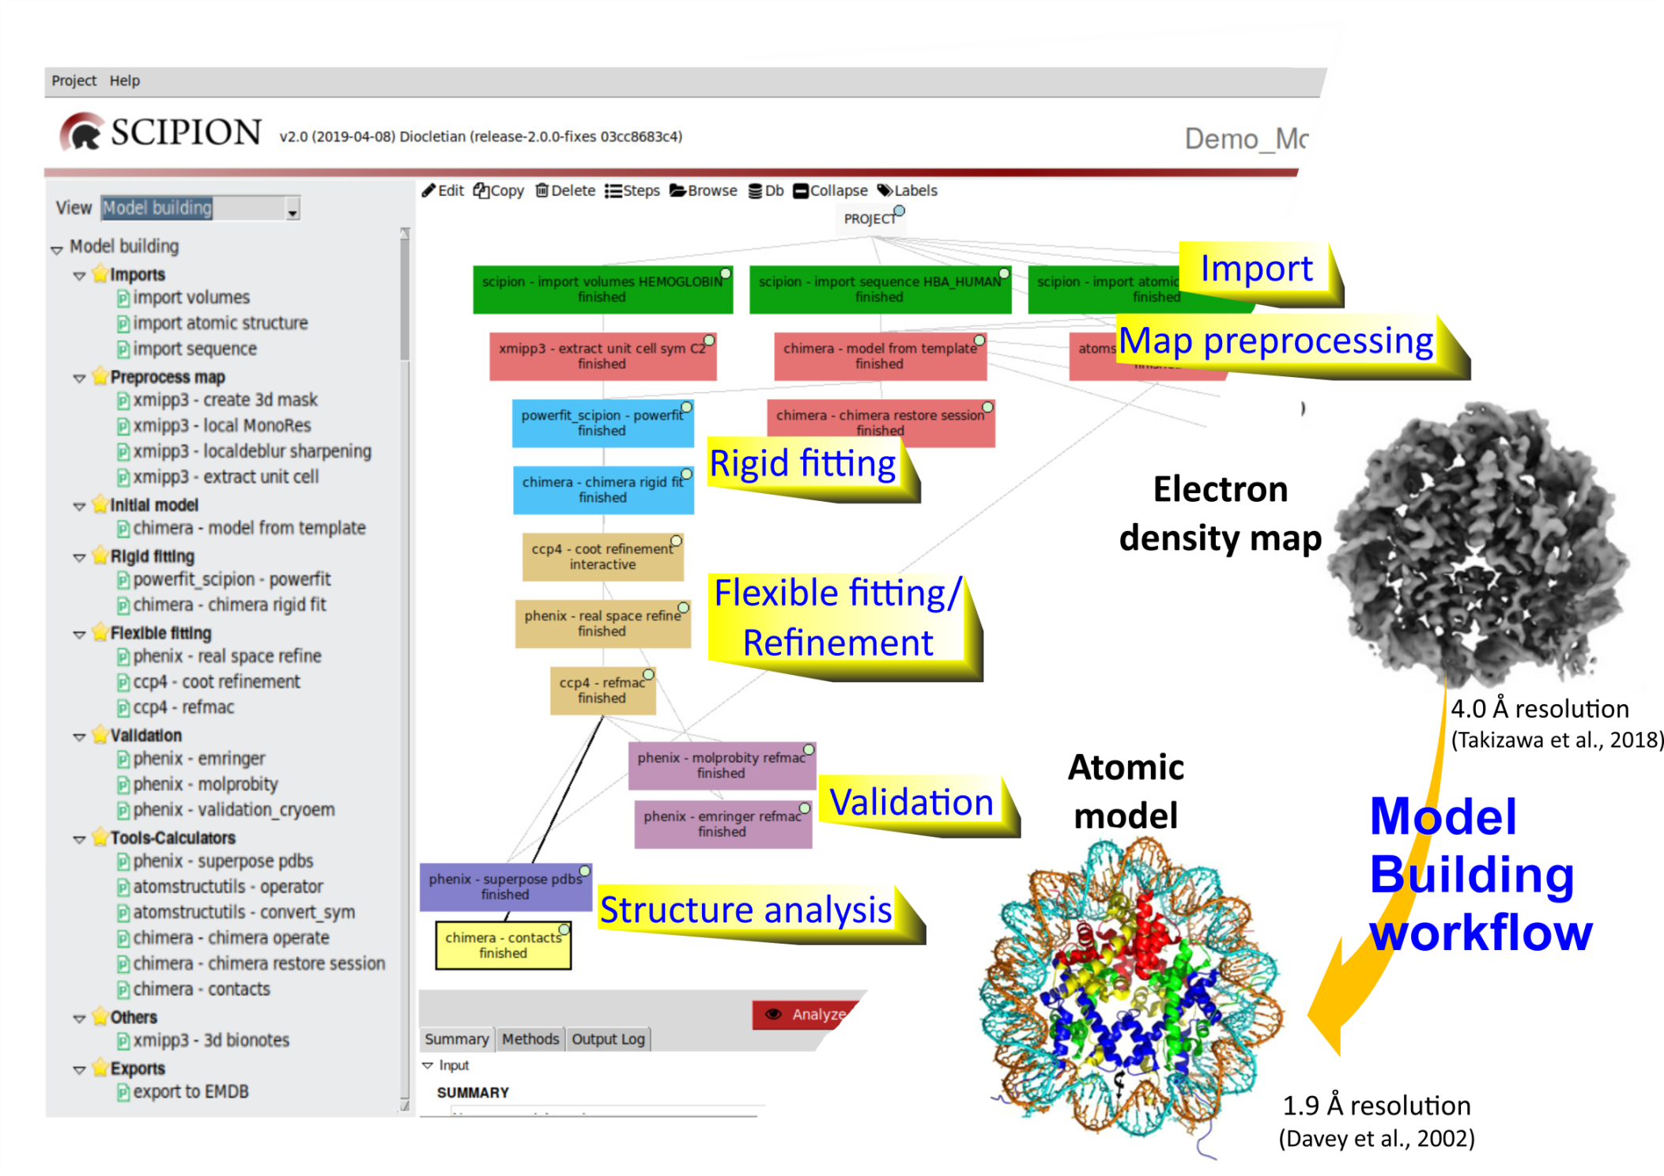

Martínez M et al. Integration of Cryo-EM Model Building Software in Scipion. J Chem Inf Model. 2020

Slide 26
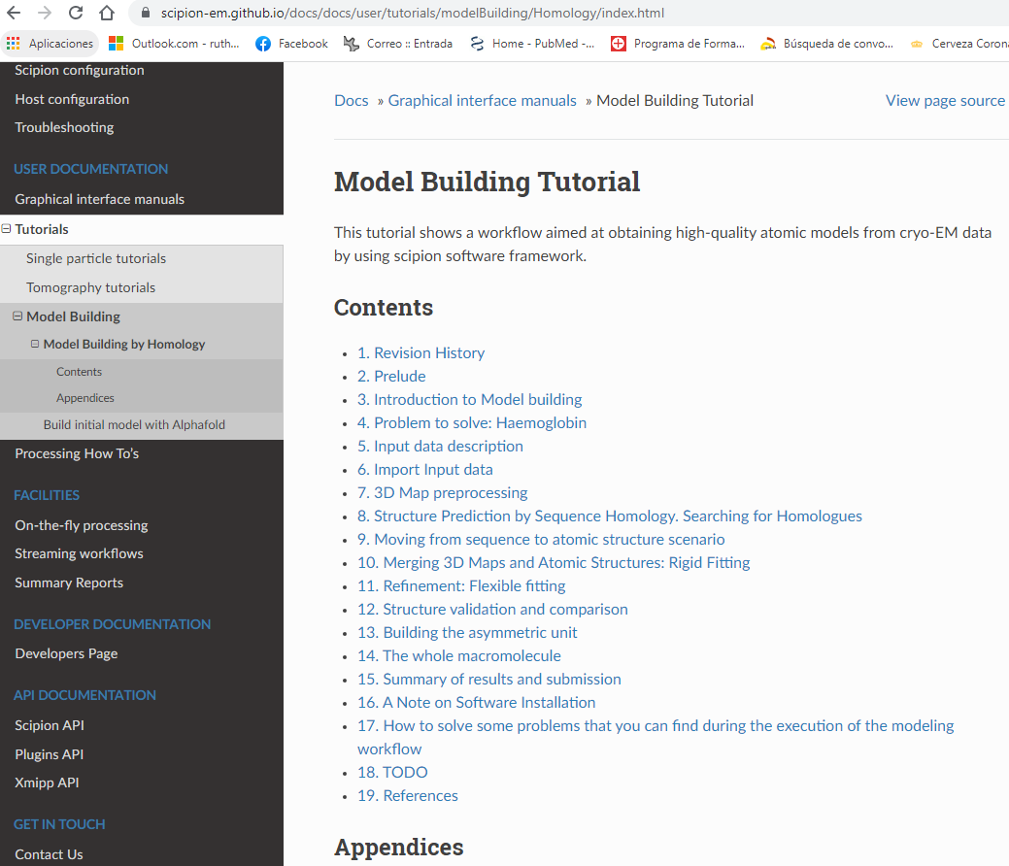
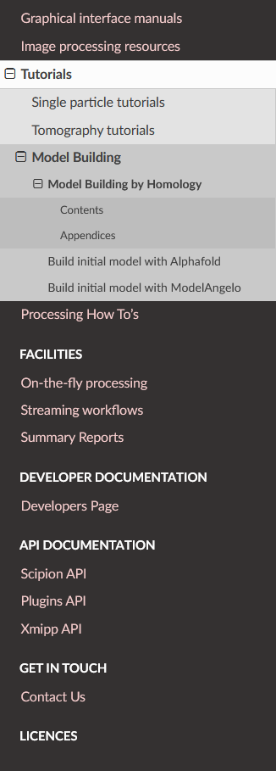

https://scipion-em.github.io/docs/release-3.0.0/docs/user/user-documentation.html#model-building

